Slide 1
ELEMENTS AND CHARACTERISTICS OF TECHNICAL WRITING

Slide 2
WHAT IS TECHNICAL WRITING ?
TECHNICAL WRITING IS A WRITING IN WHICH A PROFESSIONAL WHO PRODUCES TECHNIAL DOCUMENTS SUCH AS RESEARCH PURPOSAL , JOB APPLICATION ,COVER LETTER ,PROJECT SYNOPSIS OR LAB MANUAL IN A PRECISE MANNER ACCORDING TO SOME DEFINED RULES OF WRITING.

Slide 3
ELEMENTS OF TECHNICAL WRITINGS
Background of study
Statement of the problem
Significance of the study
Limitation of the study
Definition of terms
Methodology
Organization
Supporting material

Slide 4
BACKGROUND OF STUDY
Background information identifies and describes the history and nature of a well-defined research problem with reference to the existing literature. The background information should indicate the root of the problem being studied, its scope, and the extent to which previous studies have successfully investigated the problem, noting, in particular, where gaps exist that your study attempts to address.

Slide 5
STATEMENT OF PROBLEM
A problem statement is a brief piece of writing that usually comes at the beginning of a report or proposal to explain the problem or issue the document is addressing to the reader. In general, a problem statement will outline the basic facts of the problem, explain why the problem matters, and pinpoint a solution as quickly and directly as possible.

Slide 6
SIGNIFICANCE OF STUDY
May resolve theoretical questions in your area
May develop better theoretical models in your area
May influence public policy
May change the way people do their jobs in a particular field, or may change the way people live

Slide 7



LIMITATIONS OF STUDY

Slide 8
DEFINITIONS OF TERMS
Every scientific term should be well defined
in our:
1. Study
2. Research Proposal
3. Research Report

Slide 9




METHODOLOGY
Experimental Design

Slide 10
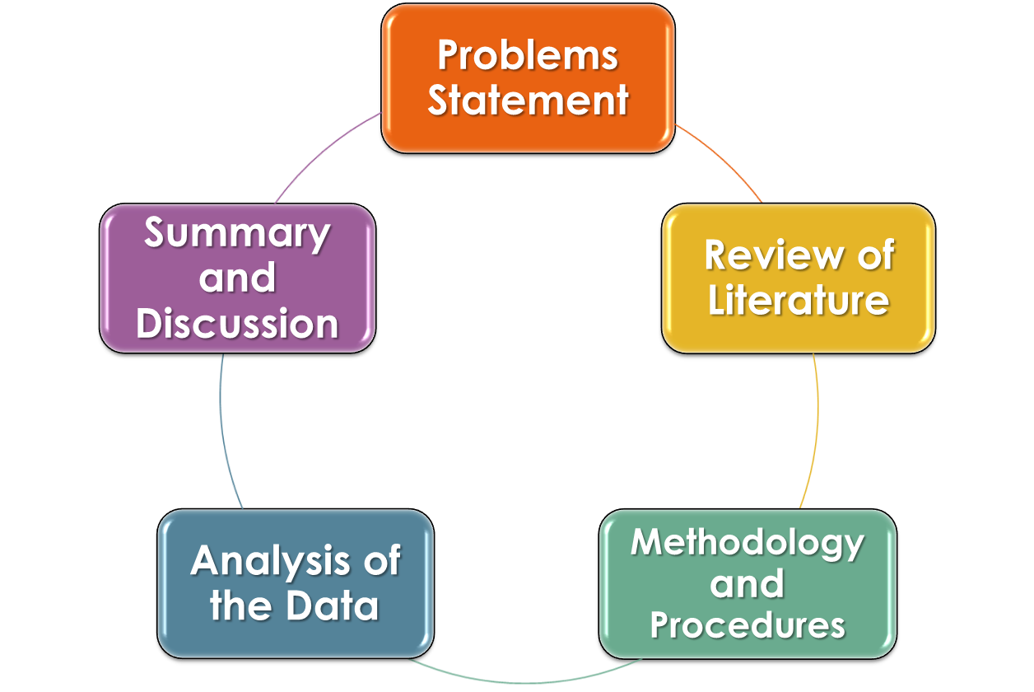
ORGANIZATION

Slide 11

SUPPORTING MATERIAL
Supporting material add glitter to your research material
Types of supporting material:
Examples
Facts and Statistics
Experience
Previous Researches and Laws

Slide 12
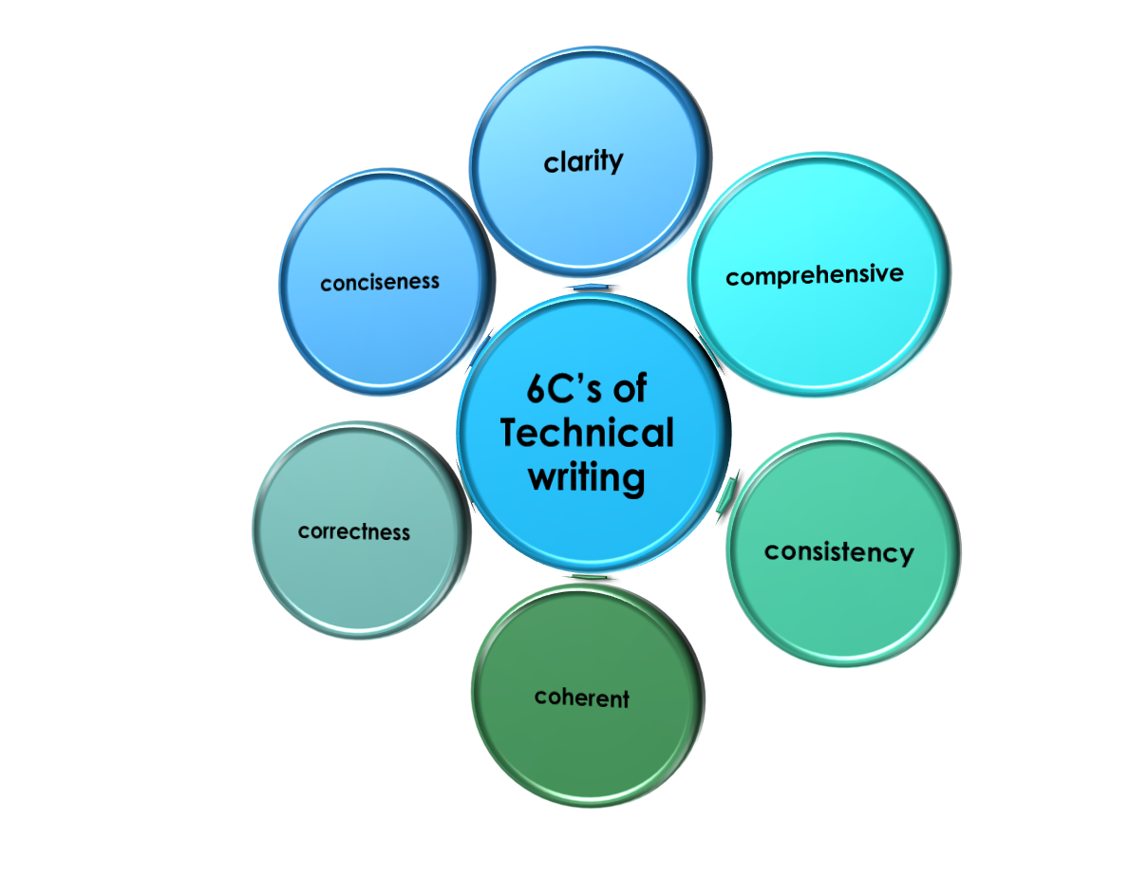
Six C’s And Other Characteristics Of Technical Writing

Slide 13

CLARITY
The written document must convey a single meaning that the reader can easily understand. Unclear technical writing leads to wasted time, money and resources.
Write legibly; make simple, neat corrections
Choose exact words
State the central idea (in a thesis statement or topic sentence)
Give facts and examples to support generalizations
If you must abbreviate, define the term in its first occurrence and put abbreviations in parentheses
Example:
Standard Pressure and Volume (STP)

Slide 14

COMPREHENSIVENESS
A comprehensive technical document provides all the information its readers will need
Readers who must act on a document need to be able to apply the information efficiently and effectively

Slide 15

CONSISTENCY
Consistency in the context of written communication mean orderly treatment of a set of linked elements in a document
It can seem boring ,but if you use the simplest and most clear language possible , all readers should interpret the instruction correctly
Adding unnecessary adjectives , articles and adverbs just gives the reader opportunities to confuse the matter
Consistency is formatting the document properly
Example:
Use Times Roman typeface
Maintain 12 point font size

Slide 16
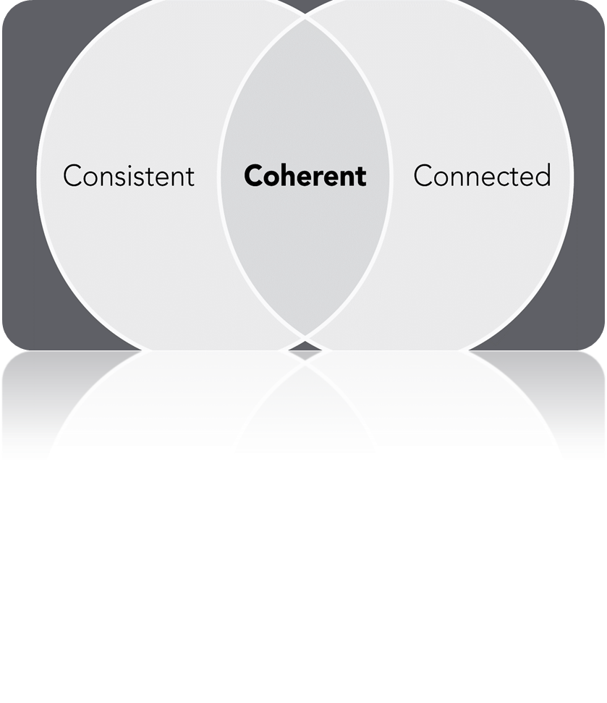
COHERENCE
Coherence is achieved when sentences and ideas are connected and flow together smoothly
Logical
Reasonable
Well Organized
Comprehensible
Orderly Arranged

Slide 17
connecting ideas and making them easy to understand
Ensure items in a series have parallel structure
Show relationships between ideas by using linking words (and, if, when, before, after)
List items in a series to make them stand out
Clarify relationships with numbering
Use headings to highlight and introduce main ideas

Slide 18

CORRECTNESS
Good technical writing observes the conventions of grammar, spelling, punctuation, and usage. Leaving sloppy grammar errors in your writing is like wearing a soup-stained shirt to a business meeting: it will distract your readers, and may make them doubt the importance of your information.

Slide 19
CONCISENESS
To be useful, technical writing must be concise. The longer a document is, the more difficult it is to use, for the obvious reason that it takes more of the reader’s time. A document must strive to balance the claims of clarity, conciseness, and comprehensiveness; it must be long enough to be clear given the audience, purpose, and subject but not a word longer.
Its opposite is pleonasm, which is using many words where few will do
Documents must often fit in a specific physical space
Resume must be of one page
Car owner’s manual must fit in glove box
Use short words instead of wordy expressions

Slide 20
Other characteristics of technical writing
Readable
Tactful
Personal
Positive
Active
Unified
Mechanically sound
Proof reading
References
Accuracy

Slide 21

Readable
Readability is the ease with which a reader can understand a written text
The readability of text depends on its content and typography (font size, line height, and line length)

Slide 22
Tactful
Taking care to not offend or alienate the reader
Avoid language bias (gender, cultural, religious,
age,
Use humor appropriately

Slide 23
Personal
Delivering a message to the reader rather than from the writer
If appropriate, frequently use second person pronouns such as “you” in your writing
When using the third person, think about how you can direct the message to your reader
Be empathetic and try to consider your reader’s needs and point of view

Slide 24
Positive
Using a tone that encourages a positive interpretation
Highlight positive information by placing it at the beginning or end of the message.
Where necessary, use repetition for emphasizing the positive

Slide 25
Active
Applying the active voice to focus on the “doer”
Use the active voice most of the time to be more emphatic and concise.
Choose the passive voice if you wish to de-emphasize (or don’t know) the identity of the “doer.”

Slide 26
Unified
Including only information related to the main message
Ensure all ideas in the document relate to the overall purpose
Eliminate unnecessary details
Clearly indicate how ideas within sentences relate to one another
Check that paragraphs do not contain more than one central idea

Slide 27

Mechanically sound
Graphical representation of your ideas:
Back bone of your laws and ideas
Helps in brief description
Necessary for argument research paper
For efficient illustration

Slide 28

Mathematical proofs
Mathematics is the mother of all sciences
Visual background of your ideas.
Importance of calculations and measurements
Approach to approximate answer
Provide a hypothetical path-way

Slide 29

Proof Reading
Avoid mistakes
Avoid misdealing and misunderstanding
Different strategies for proof reading
Proof reader should be a technical writer

Slide 30

References
Contribution of other people on specified topics
Importance of the foot notes
Plagiarism
Resources include books, foot notes, general articles, personal experience, reference within a same resource and previous research

Slide 31
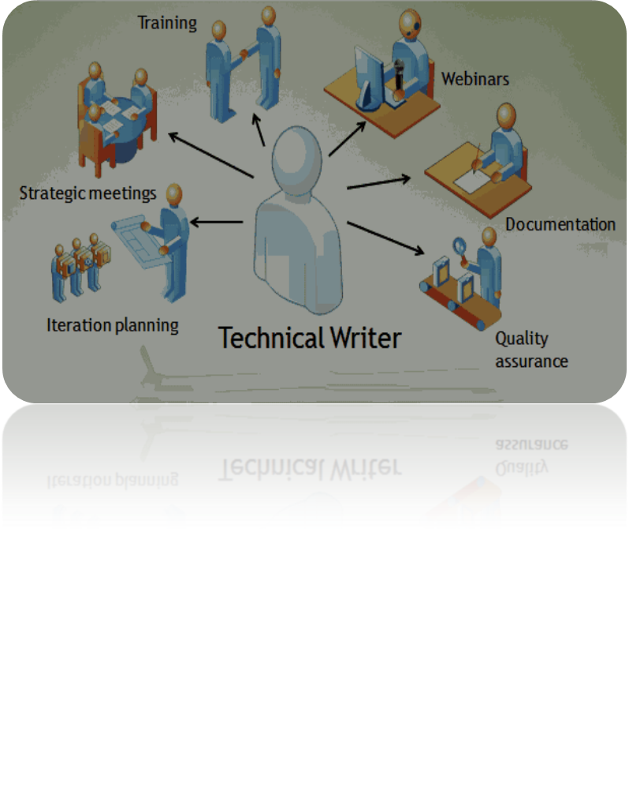
Accuracy
This means to not only be careful to avoid errors in recording facts; it also means freedom from bias or subjectivity. If readers suspect you are slanting information by overstating the significance of a particular point, they have every right to doubt the validity of the entire document.

Slide 32

RULES TO BE FOLLOWED
Always use normal language
Avoid unnecessary proverbs and sentences
Always focus the reader to exact point
Strictly bound to your point of view

